Slide 1
CIS 4526 Foundations of Machine Learning
Chapter 3
Probability and Statistics Review

Slide 2
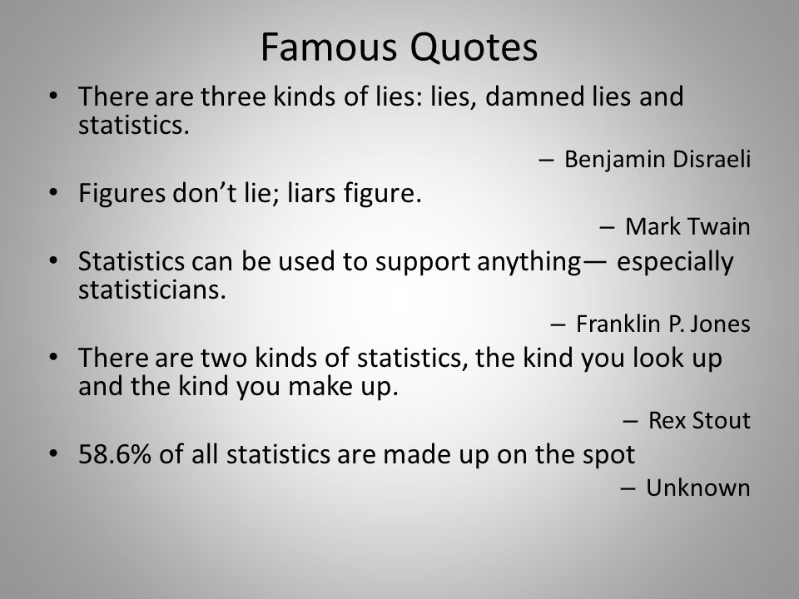

Slide 3
Then why do we still care?
A data scientist is someone who is better at statistics than any software engineer and better at software engineering than any statistician”. – Josh Wills on Quora
http://www.mastersindatascience.org/careers/data-scientist/

Slide 4
Outline
Introduction
Why
Two kinds of Statistics
Descriptive Statistics
Sampling
Standard Deviation
Skew
Kurtosis
Inferential Statistics
Correlation and Causation
Hypothesis Testing

Slide 5
Outline
Introduction
Why
Two kinds of Statistics
Descriptive Statistics
Sampling
Standard Deviation
Skew
Kurtosis
Inferential Statistics
Correlation and Causation
Hypothesis Testing

Slide 6
Why Statistics Again?
The world is not deterministic, in other words we need to deal with randomness
We only live once. What we observe is only ONE realization of many possibility. In another universe, you may be the professor while I may be the student
However, if there are some underlying truth (such as the sun will always rise from the east or a human being will not grow more than 8 feet), you will see pretty much the same thing again and again if you can make multiple observations from the same underlying mechanism.
Observations will have a lot of noise. The Signal to Noise ratio will be extremely important.
Question to ask is whether the conclusion you draw from your observation is statistically significant.

Slide 7
Importance of Statistics
Cannot just say I am a genius. I know what I am doing. Believe me!
Statistics is the language of Randomness
Can only qualify your statements with certain probability
Interested only in conclusions that are Statistically Significance
This is what Data Analytics is all about.
Science behind drawing meaningful conclusions from observations

Slide 8
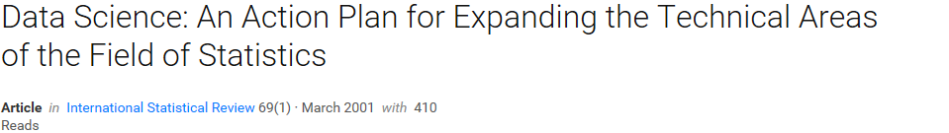
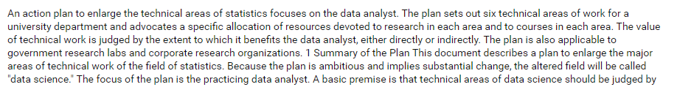
In fact … Data science first appeared in a statistics paper
In 2001, William S. Cleveland published a research paper that coined the term “Data Science” the first time
Computer Science + data mining = Make statistics a lot more technical
= Data Science

Slide 9
Importance of Statistics
Some even prefers referring the study as Statistical Learning over Machine Learning
From Introduction To Statistical Learning:
Statistical learning refers to a set of tools for modeling and understanding
complex datasets. It is a recently developed area in statistics and blends
with parallel developments in computer science and, in particular, machine
learning.
Since that time, inspired by the advent of machine learning and other
disciplines, statistical learning has emerged as a new subfield in statistics,
focused on supervised and unsupervised modeling and prediction.

Slide 10
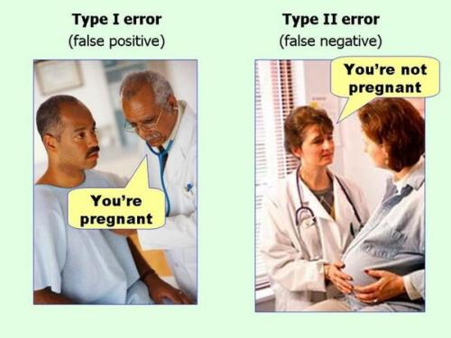
Know your Statistics (terms you that need to understand well)
Mean, Standard Deviation
Distribution
Law of large numbers
Statistical Significance
Survival Bias
Bias vs Variance

Slide 11
Two kind of Statistics
Descriptive Statistics vs Inferential Statistics
Descriptive Statistics consists of organizing and summarizing data.
Mean, Standard Deviation, Skew, Quantile, Ranks
Inferential Statistics (Predictive Statistics) consists of using data you have collected to form conclusions
Hypothesis testing
Estimation (Use sample mean to predict population mean)

Slide 12
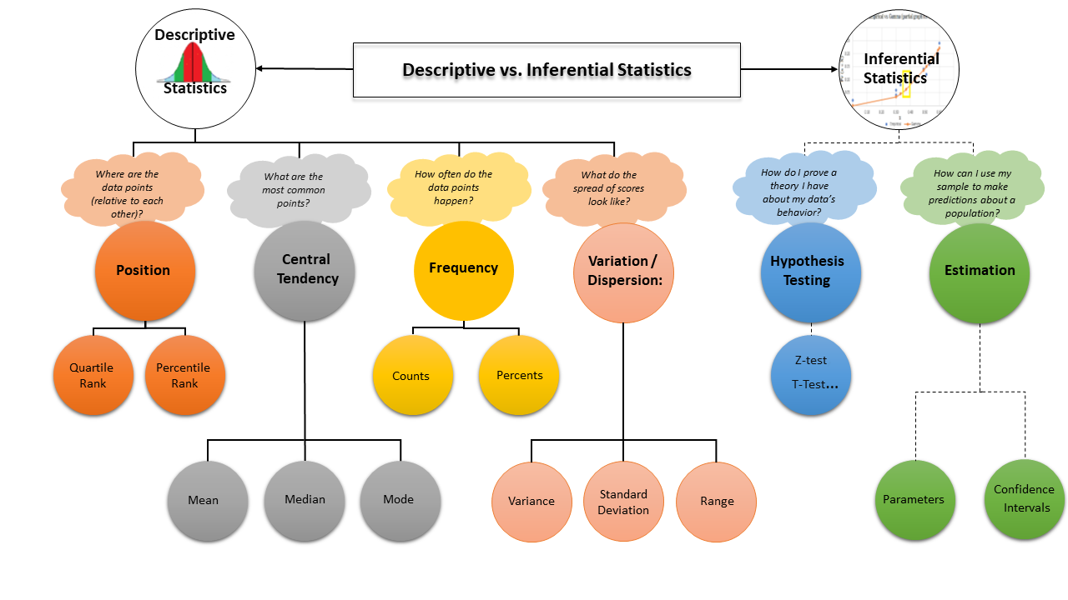
Two kind of Statistics

Slide 13
Outline
Introduction
Why
Two kinds of Statistics
Descriptive Statistics
Sampling
Standard Deviation
Skew
Kurtosis
Inferential Statistics
Correlation and Causation
Hypothesis Testing

Slide 14
Machine Learning starts with Data
Data Mining or any ML starts with data;
Data are collected by sampling
Therefore, it’s important to understand the sampling process and the different ways of sampling

Slide 15

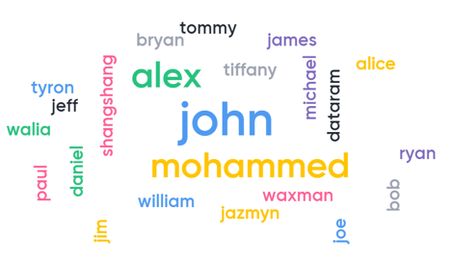
Let’s start with an example
Question: What is the most common name in US?
Answer: To help answer this question, why don’t you submit your name in an online survey

Slide 16
What have we done?
We have just done a so-called Convenience Sampling
Individuals or samples are selected based on their availability and willingness to take part
It is one of the easiest sampling methods
What is the problem though? Anyone?
Not enough samples
May have bias
Systematic Bias
Survival Bias

Slide 17
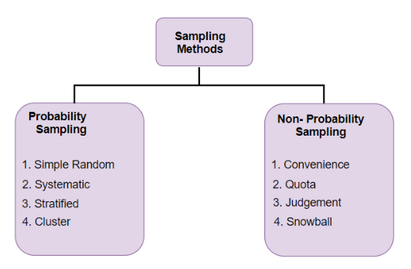
Importance of Correct Sampling
Population vs Sample
The population is the entire group you are interested in studying.
A sample is a subset of the population, a select group of information taken from a population.
Sampling Methods
Random Sampling
Stratified Sampling
Systematic Sampling
Convenience Sampling
Reference:
https://www.analyticsvidhya.com/blog/2019/09/data-scientists-guide-8-types-of-sampling-techniques/?utm_source=feedburner&utm_medium=email&utm_campaign=Feed%3A+AnalyticsVidhya+%28Analytics+Vidhya%29

Slide 18
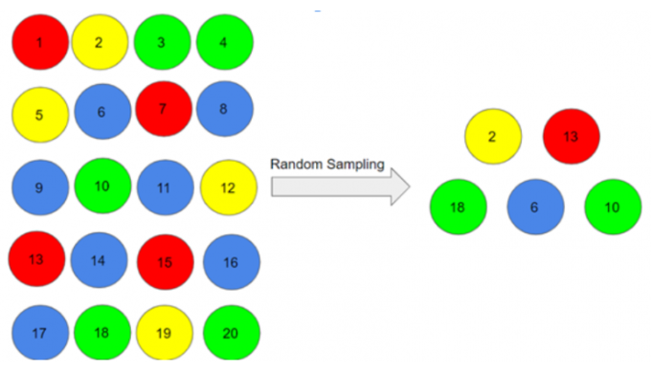
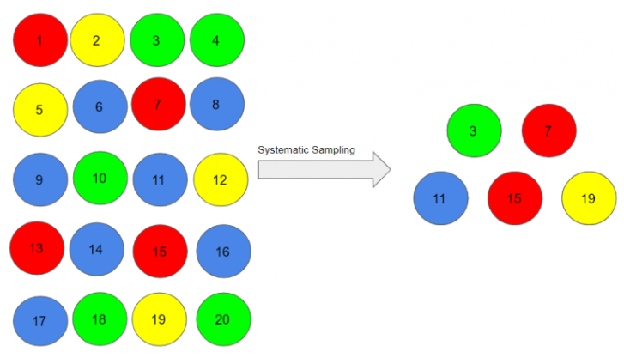
Types of Sampling
Random Sampling
Systematic Sampling
Pro: simple; reduce selection bias
Con: may not have enough sample with characteristics of interest
Pro: simple; easy to implement
Con: may lead to bias if there is an underlying pattern in the way we select items (even the chance is low)

Slide 19
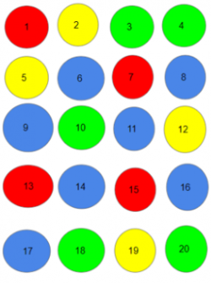
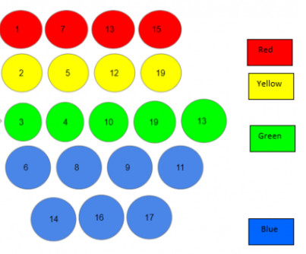


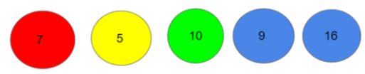
Types of Sampling
Stratified Sampling: divide the population into subgroups (called strata) based on different traits, then we sample from these subgroups
Pro: ensure enough representation from all subgroups
Con: need proper knowledge of the characteristics of the population
subgrouping
Sampling

Slide 20
Sampling is important but often ignored
Imagine your boss ask you to join a model research presentation from a vendor.
You are not really an expert in the area of the presentation, but how can you ask questions that will show you are smarter than you actually are?
Answer:
How do you collect the data?
Does your dataset have bias?

Slide 21
Excellent Online Resource for Statistics Review
http://www.statisticslectures.com/topics/statistics/ is an excellent online resource for quick review
Basics of Probability
Discrete and Continuous Random Variables
Probability Distribution
Mean and Expected Value
Law of Large Numbers
Central Limit Theorem
Normal Distributions
Sampling
Hypothesis Testing
Type I and Type II Errors
P-value
One-tail tests
Conditional Probability
Bayes Rules

Slide 22



Descriptive Statistics
Central tendency refers to the measure used to determine the center of a distribution of data. It is used to find a single score that is most representative of an entire data set
Mean, Median and Mode
Mean is the most common single statistics (number) to describe an entire data set.
However, it is very sensitive to outliers.
Example: mean of the age of students in a college class: { 18, 19, 19, 17, 60}
Median is the number that lies in the middle after the data set is sorted.
Mode is simply the most frequently occurring value
Example Dataset:
Mean is 2.8
Median is (2+3)/2 = 2.5
Mode is 2 because it occurs the most frequently

Slide 23
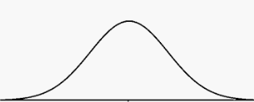
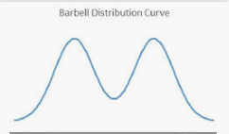
Descriptive Statistics
Two very different distribution could have the same mean and median
Example: dataset1 { 16, 18, 18, 18, 18, 18, 18, 20 }
dataset2 { 8, 8, 8, 18, 18, 28, 28, 28 }
So, we need more descriptive statistics to describe a
distribution
Standard Deviation, Skew, Kurtosis

Slide 24
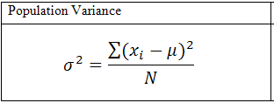
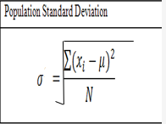
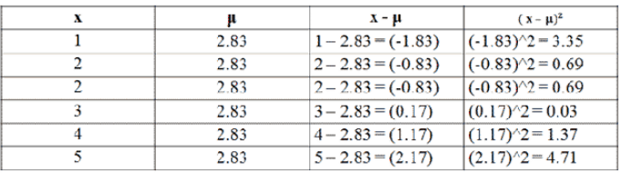

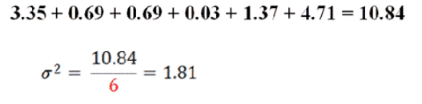
Standard Deviation or Variance
Dispersion refers to how spread out a data set is about the mean.
Variance and Standard Deviation are two measures of dispersion within a data set.
Example Dataset: {1, 2, 2, 3, 4, 5}
denotes the mean

Slide 25
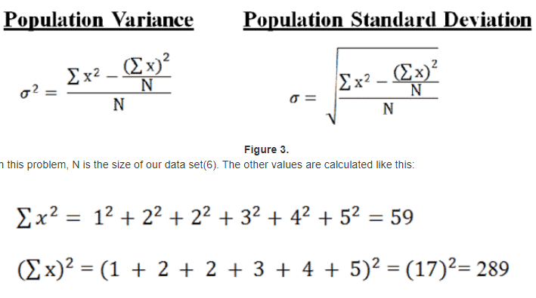
Second Equivalent Formula For Variance
After plugging in all the values, we again find a variance of 1.81, and a standard deviation of 1.35.

Slide 26
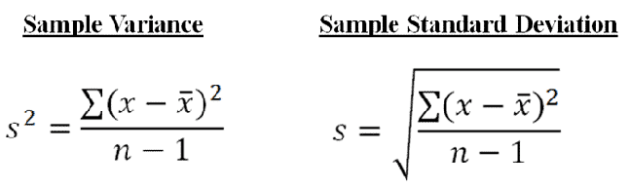
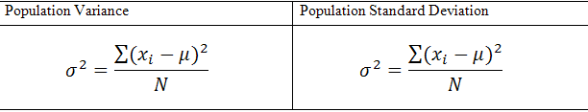
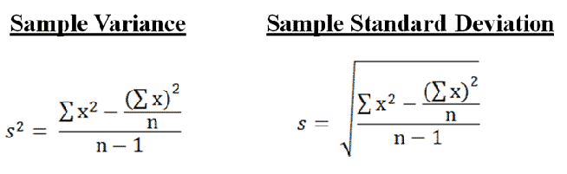
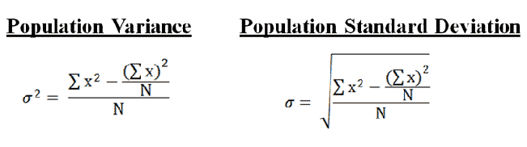
Sample Variance vs Population Variance
N denotes the Population size, n is the sample size

Slide 27
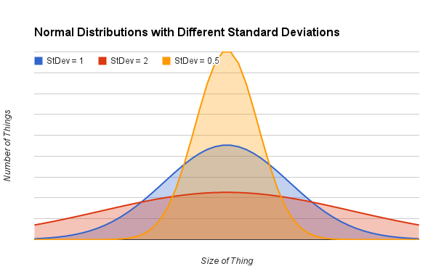
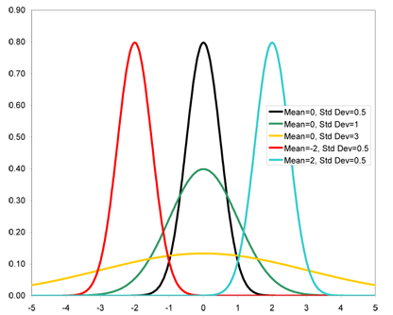
Standard Deviation
Standard Deviation as a metric to describe how “wide” or “spread-out” the distribution is.

Slide 28
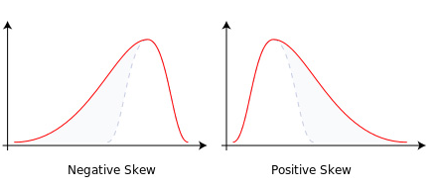
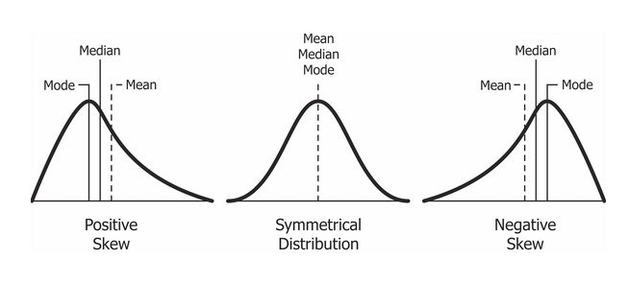
Skew
Skewness is the degree of distortion from the symmetrical bell curve or the normal curve. It measures the lack of symmetry in data distribution. It differentiates extreme values in one versus the other tail. A symmetrical distribution will have a skewness of 0.

Slide 29
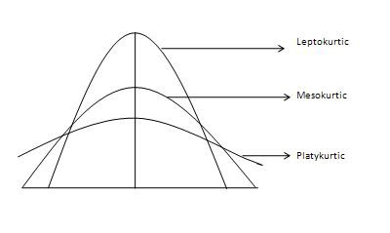
Kurtosis
Kurtosis, on the other hand, refers to the pointedness of a peak or the tails in the distribution curve. The main difference between skewness and kurtosis is that the former talks of the degree of symmetry, whereas the latter talks of the degree of peakedness (or tailedness) in the frequency distribution.
Mesokurtic: This distribution has kurtosis statistic similar to that of the normal distribution. The standard normal distribution has a kurtosis of three. Leptokurtic (Kurtosis > 3): tails are fatter, has more outliers. Peak is higher and sharper than Mesokurtic Platykurtic: (Kurtosis < 3): tails are thinner, has less outliers than the normal distribution. The peak is lower
In Pandas the kurtosis definition is slightly different. Normal distribution has a zero Kurtosis. Leptokurtic kurtosis is > 0 and Platykurtic kurtosis is < 0

Slide 30
Outline
Introduction
Why
Two kinds of Statistics
Descriptive Statistics
Sampling
Standard Deviation
Skew
Kurtosis
Inferential Statistics
Correlation and Causation
Hypothesis Testing

Slide 31
Questions
What are the factors that drive house prices in a city?
Mortgage Rates
Unemployment Rates
Local School performance
…

Slide 32
Questions
How would you determine which factors are really important in 5 minutes
(ie without developing any models)?

Slide 33
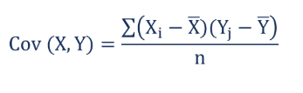
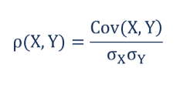
Covariance and Correlation
Covariance measures the linear relationship between two variables.
Positive covariance: Indicates that two variables tend to move in the same direction.
Negative covariance: Reveals that two variables tend to move in inverse directions
Covariance can range from negative infinity to positive infinity.
Correlation is the scaled measure of covariance. It is dimensionless.
In other words, the correlation coefficient is always a pure value and
not measured in any units.
Correlation is between -1 and +1
ρ(X,Y) – the correlation between X and Y
Cov(X,Y) – the covariance between X and Y
σ_{X} – the standard deviation of X
σ_{Y} – the standard deviation of Y
https://corporatefinanceinstitute.com/resources/knowledge/finance/covariance/

Slide 34
Covariance and Correlation
Pearson product moment correlation
The Pearson correlation evaluates the linear relationship between two continuous variables. A relationship is linear when a change in one variable is associated with a proportional change in the other variable.
For example, you might use a Pearson correlation to evaluate whether home price increase in a city is related to the unemployment rate in that area.
Spearman rank-order correlation
The Spearman correlation evaluates the monotonic relationship between two continuous or ordinal variables.
In a monotonic relationship, the variables tend to change together, but not necessarily at a constant rate.
The Spearman correlation coefficient is based on the ranked values for each variable rather than the raw data.
Spearman correlation is often used for ordinal variables. For example, you might use a Spearman correlation to study how the order in which employees complete a test exercise is related to the months they have been employed.
In a scatterplot, Pearson Correlation coefficients measure linear relationship while Spearman is more concerned on whether the relationships is monotonic or not.

Slide 35
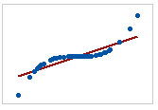
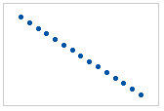
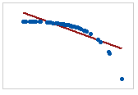
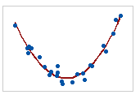
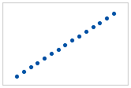
Pearson vs Spearman Correlation
Fig 1
Fig 2
Fig 3
Fig 4
Fig 5
Pearson: +1
Spearman: +1
Pearson: ?
Spearman: ?
Pearson: -1
Spearman: -1
Pearson: ?
Spearman: ?
Pearson: ?
Spearman: ?

Slide 36
Pearson vs Spearman Correlation
Fig 1
Fig 2
Fig 3
Fig 4
Fig 5
Pearson: +1
Spearman: +1
Pearson: +0.85
Spearman: +1
Pearson: -1
Spearman: -1
Pearson: -0.85
Spearman: -1
Pearson: 0
Spearman: 0
Zero correlation does not mean the variables are independent
Low correlation does not mean there is no dependence between two variables
https://support.minitab.com/en-us/minitab-express/1/help-and-how-to/modeling-statistics/regression/supporting-topics/basics/a-comparison-of-the-pearson-and-spearman-correlation-methods/

Slide 37
Question
Have you heard of eating ice cream can turn you into a murderer?

Slide 38
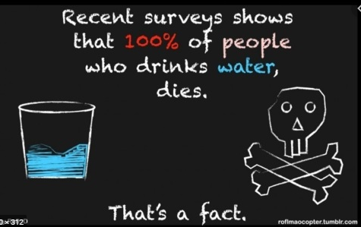
Correlation and Causation
Causation will lead to high correlation, but high correlation may not necessarily imply causation relationship
Classic Example: Murder rates goes up when ice cream sales go up
The rates of violent crime and murder have been known to jump when ice cream sales do. But, presumably, buying ice cream doesn't turn you into a killer (unless they're out of your favorite kind?)
But, correlation is still one good tool to identify driving factors.
https://science.howstuffworks.com/innovation/science-questions/10-correlations-that-are-not-causations.htm
https://www.georanker.com/correlation-vs-causality-differences-and-examples

Slide 39
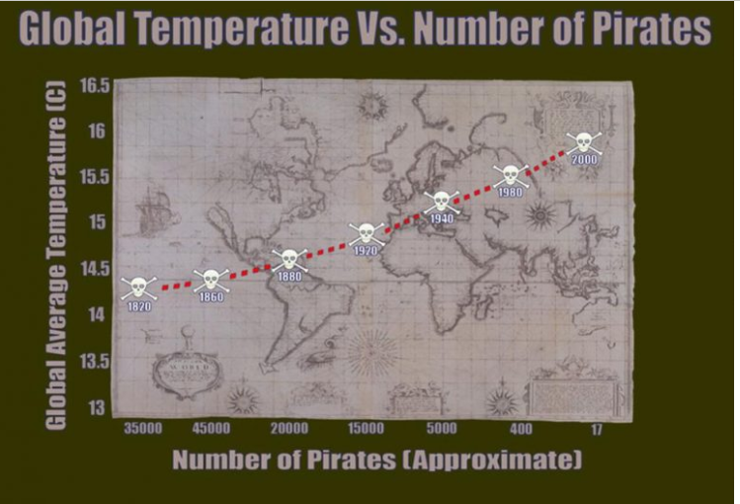
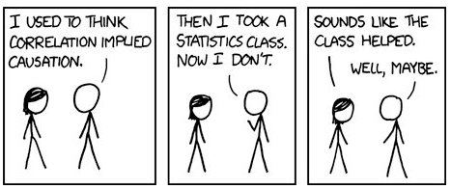
Correlation and Causation
Global Warming caused by Lack of Pirate
https://www.sisense.com/blog/global-warming-caused-lack-pirates-bad-graph-lessons/

Slide 40
Inferential Statistics / Predictive Statistics
http://www.statisticslectures.com/topics/statistics

Slide 41
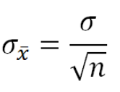
Inferential Statistics – making estimations of the population from samples
Parameters: A characteristic that describes a population is called a parameter. Because it is often difficult (or impossible) to measure an entire population, parameters are most often estimated
http://www.statisticslectures.com/topics/parametersstatistics/
Statistic: A characteristic that describes a sample is called a statistic. Statistics are most often used to estimate the value of unknown parameters
http://www.statisticslectures.com/topics/distributionsamplemean/
http://www.statisticslectures.com/topics/centrallimittheorem/
Distribution of Sample Mean:
The Central Limit Theorem: Independent of the actual distribution of the population, if we take a big enough sample size, when we repeat taking sample again and again, the distribution of the sample mean follows a normal distribution.
That is why we can often use the normal distribution behind hypothesis testing

Slide 42
Hypothesis Testing
Type I error (false positive, too excited to claim something non-existence)
Type II error (false negative, failed to realize something real is going on)
Null Hypothesis (nothing to see, life is as usual)
Alternate Hypothesis (something is going on)
1. Define Null and Alternative Hypotheses
2. State Alpha (10%, 5% or 1%)
3. State Decision Rule
4. Calculate Test Statistic
5. State Results
6. State Conclusion
http://www.statisticslectures.com/topics/typeonetypetwoerrors/
http://www.statisticslectures.com/topics/onetailtwotail/
http://www.statisticslectures.com/topics/onesamplez/

Slide 43
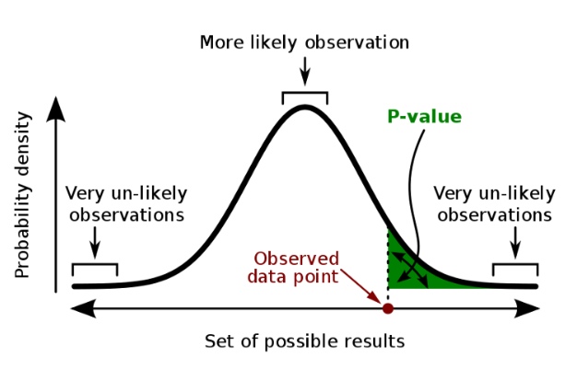
P-value and Confidence interval
https://www.youtube.com/watch?v=vemZtEM63GY

Slide 44
Appendix: Online Statistics Review
Watch the Recommended Statistics Lectures as much as you could
http://www.statisticslectures.com/topics/statistics

Slide 45
Appendix: Statistics Review
Descriptive and Inferential Statistics http://www.statisticslectures.com/topics/descriptiveinferential/
Population vs Sample http://www.statisticslectures.com/topics/samplingmethods/
Parameters, Statistics and Sampling Errors http://www.statisticslectures.com/topics/parametersstatistics/
Distribution of Sample Mean http://www.statisticslectures.com/topics/distributionsamplemean/
Mean and Expected value of a probability http://www.statisticslectures.com/topics/meanexpectedvaluediscrete/
Variance and Standard deviations http://www.statisticslectures.com/topics/variancestandarddeviationdiscrete/
Law of Large Numbers, Central Limit Theorem http://www.statisticslectures.com/topics/centrallimittheorem/
Skew and Kurtosis explained:
https://keydifferences.com/differences-between-skewness-and-kurtosis.html
https://codeburst.io/2-important-statistics-terms-you-need-to-know-in-data-science-skewness-and-kurtosis-388fef94eeaa
https://stats.idre.ucla.edu/other/mult-pkg/faq/general/faq-whats-with-the-different-formulas-for-kurtosis/
https://www.itl.nist.gov/div898/handbook/eda/section3/eda35b.htm#:~:text=Kurtosis%20is%20a%20measure%20of,would%20be%20the%20extreme%20case.

